Slide 1
Netherlands Cooperative
1852 Columbia Rd. NW
Use of Reserve Study
and
History of Assessments and Projects

Slide 2
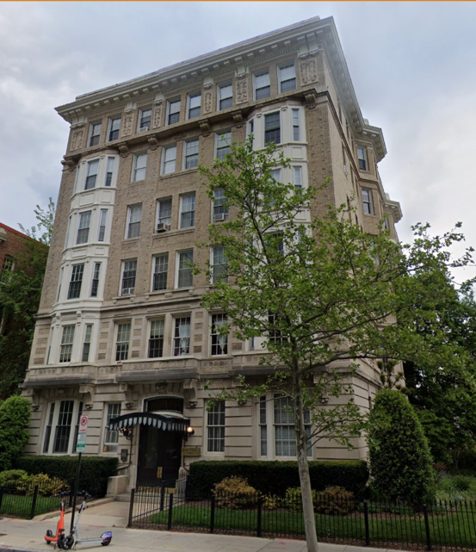
Built in 1908
Became a Coop in 1920
Previous property manager: TBM
Current property manager: EJF Real Estate
30 units (plus 1 rental)
Assessment allocation based on shares established at the founding of the Coop.
Reserve studies had been done in the past (as recently as 2015), but largely ignored.

Slide 3
Prior to 2020
Contributions to the replacement reserve were generally about $30k per year. That was about 12% of total annual revenues.
Previous reserve studies suggested that contributions should be about $65k per year
Funding for large projects was generally done through special assessments

Slide 4
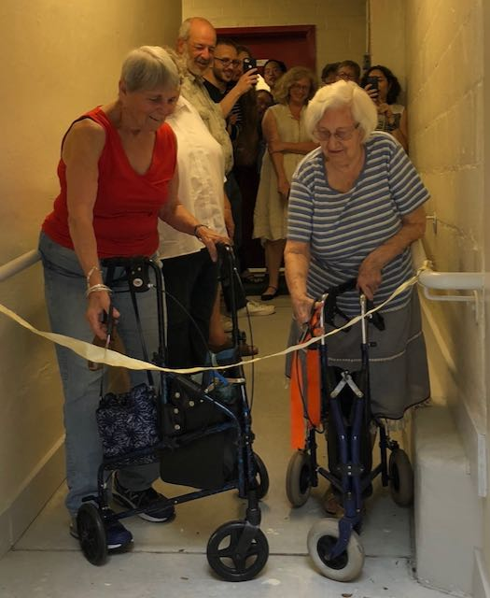
The last project done under prior leadership:
Back door ramp project – completed in 2019
Total cost about $75k, split between existing budget and a 2-year special assessment
Long process to approve funding
Budget lacked transparency
Major turn-over of Board in January 2020
New Board began a process of
Communication with members
Stepping up reserve contributions and
Contracted for a new reserve study

Slide 5
Examples of Board communications to members in late 2020
Our 2015 reserve study recommends that our reserve fund balance at the end of 2020 should be over $200,000 (our actual balance will be less than one quarter of that amount). The reserve study recommended that we make annual contributions to our replacement reserve of $49,500 per year. Our annual contribution in recent years (not including the temporary increase for the ramp project) has been $30,000 per year. The Board believes that to protect the value of our shared investment in the building we must try to fund our replacement reserve at the recommended level.
The Board would like to avoid the need for special assessments for major projects as much as possible. Special assessments complicate the budgeting process and decrease the transparency of our financial information. Special assessments also place an unfair burden on current owners at the time the expenditure needs to be made. Lastly, imposing repeated special assessment every few years sends a signal to future buyers that the building is not managing and budgeting its finances properly.

Slide 6
Looking ahead, we believe it is time to contract for a new reserve study, which we will do in 2021. An up-to-date study should help us to set a prudent level of annual contributions to the reserve, set target levels for the reserve fund balance, and help us prioritize the kind of projects we should focus on.
With a new reserve study we can set reserve contributions sufficient to keep the building attractive and functional for many years to come. Even without a new study, we believe that we need to start now stepping up our contributions above the levels of recent years.

Slide 8
Major conclusion: need to fund the reserve at about $65 k per year
We needed a much larger reserve and annual reserve contribution
We needed to start being more proactive on projects
Projects include: Upgrades, preventive measures, and appearance
Reserve study isn’t used as a schedule, but guidance on prudent funding
After the reserve report we have had subsequent walk-throughs involving Property Diagnostics, EJF Real Estate, and board members – to set priorities

Slide 9
Projects undertaken since the study was done
Restoration of canopy over front door
Replacement of mechanical furnace control with a modern digital unit
Painting of most of the interior common areas
Painting of exterior metal work (rust issues)
New furniture for roof deck
Next major project – replace and upgrade roof and roof deck
Likely next set of projects:
Painting and calking of exterior wood surfaces
Replacement of wood retaining wall between our property and the alley
Concrete walkway repairs

Slide 10
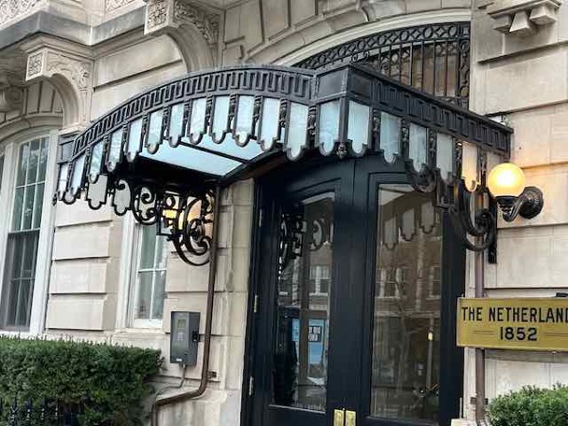
Entrance canopy project
2020 - 2021

Slide 11
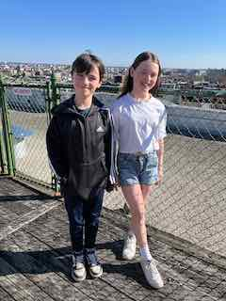
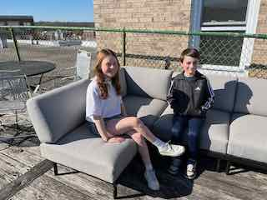
New Furniture (2023).
Replacement of roof, roof deck and roof fence (2024 or 2025).

Slide 12
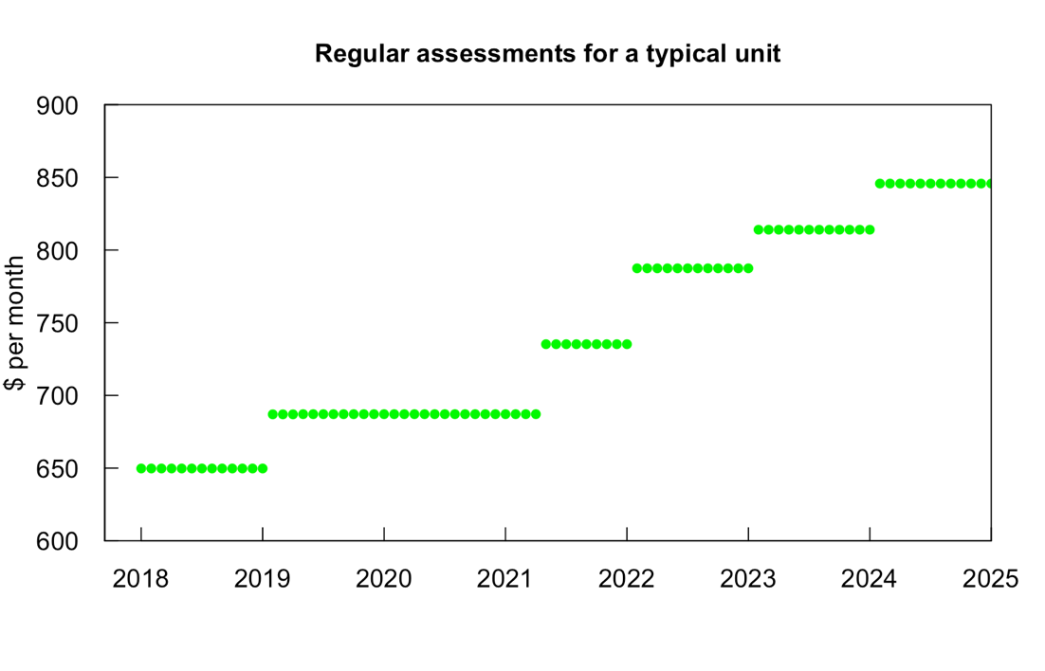
Second 7% increment to catch up on reserve contributions
First 7% increment to catch up on reserve contributions

Slide 13
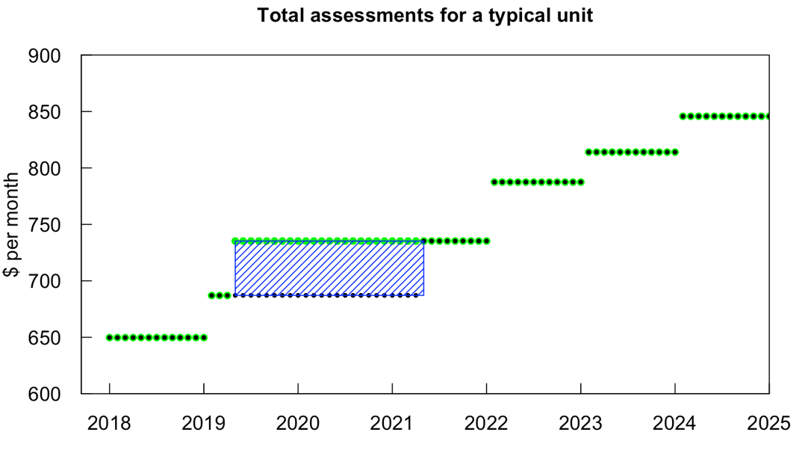
Decision to begin increasing annual reserve contributions
Special Assessment
Used the end date of special assessment as the time to start the major increase, so initially there was no “shock” to the owner’s monthly budget

Slide 14
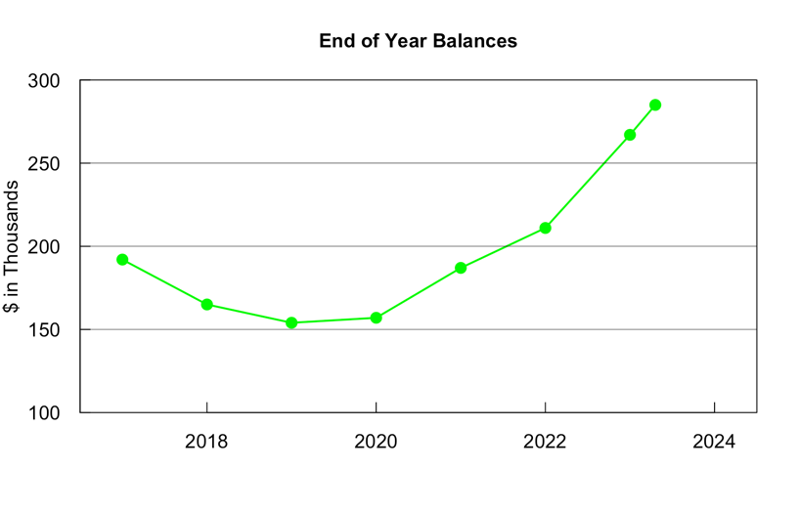
How has this changed our financial situation.
We have gone from having cash on hand of 56% of annual income at the end of 2020, to 87 % right now
Much more prepared to meet unforeseen major expenses
Less likely to need a special assessment
Less likely to need to borrow
More able to take measures to enhance our property values

Slide 15
Now earning substantial amounts of interest
EJF Real Estate now offers a service of placing reserve funds in high yield but safe investments
With American Deposit Management we have:
$130 K in money market funds at 4.25%
$70 K in a bank CD at 5.75%
On an annual basis that’s about a $10 k level of extra income – supplements our reserve contributions

Slide 16
What helped us succeed in making the change to more responsible budgeting?
Getting the Reserve study done
Sharing the reserve study with members
Opening Board meetings to member participation
Communicating regularly about this with members
Happy to take questions
If you have questions later you can write to me at
rmhirsch49@yahoo.com
Robert M. Hirsch, Board President, Netherlands Cooperative

